Slide 1
Research Update
15th December, 2023

Slide 2
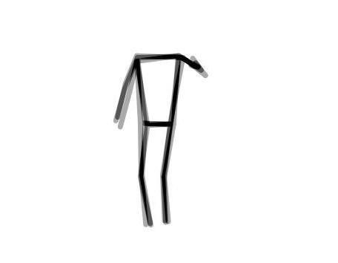
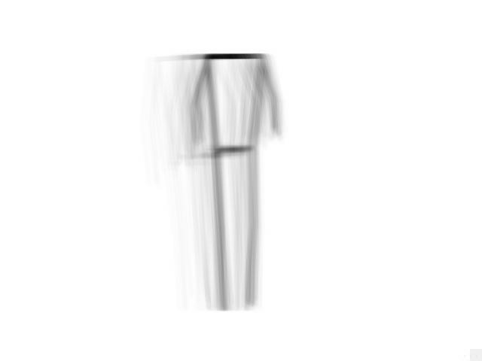
Tasks Completed
Video segmentation
  Portions of each video were divided into Front, Back, Turn, and Sideways.
  The energy images were re-generated. Since the videos were segmented, the energy images were less hazy
  Total training energy images – 291; Total testing energy images – 91; Total validation images – 41 images

Slide 3
Task Completed (continuation)
Preliminary testing on the CNNs
  Four architectures – 2-layer CNN (no dropout), 2-layer CNN (0.5 dropout), 3-layer CNN (no dropout), and 3-layer CNN (0.5 dropout)
Observation
  The training loss decreases sharply, and the training accuracy increases sharply. However, the models aren’t able to replicate this performance on the validation dataset.
  The models performs very poorly on the validation dataset, achieving accuracies not exceeding 49%.
Possible causes
  The validation dataset is very small. Some classes like MILD and SEVERE contain very few images–4 and 5 respectively
  There is some issue with the architecture, we can ever simpler or more complex architectures
  There is a lot of variation amongst the energy images. It will be imperative to standardize energy images

